Slide 1

So how do I make my images responsive?

Slide 2
Plan for today
Revisit responsiveness and media queries
Convert Bistro web page (implemented using CSS Grid) to a responsive web page.
How can I make my images more responsive?
Improve the responsiveness of the images in Bistro web page.
Introduce a CSS framework
Implement the CSS framework in the Fish Creek website

Slide 3
Flexible images
Using the max-width Property
If the max-width property is set to 100%, the image will scale down if it has to, but never scale up to be larger than its original size:
img {
max-width: 100%;
height: auto;
}

Slide 4
Flexible images
Using background-size on background images
Background images can also respond to resizing and scaling, e.g., if the background-size property is set to "contain", the background image will scale, and try to fit the content area.
div {
width: 100%;
height: 400px;
background-image: url('img_flowers.jpg');
background-repeat: no-repeat;
background-size: contain;
}

Slide 5
Flexible images
Using percentage on an image
img {
width: 100%;
height: auto;
}

Slide 6
Flexible images
Different Images for Different Devices
Use media queries to display different images on different devices.
/* For width smaller than 400px: */
body {
background-image: url('img_smallflower.jpg');
}
/* For width 400px and larger: */
@media only screen and (min-width: 400px) {
body {
background-image: url('img_flowers.jpg');
}
}

Slide 7
Flexible images
HTML5 <picture> Element
HTML5 introduced the <picture> element, which lets you define more than one image.
<picture>
<source srcset="img_smallflower.jpg" media="(max-width: 400px)">
<source srcset="img_flowers.jpg">
<img src="img_flowers.jpg" alt="Flowers">
</picture>

Slide 8
Flexible images
object-fit property
The CSS object-fit property is used to specify how an <img> or <video> should be resized to fit its container.

Slide 9
Flexible images
object-fit property
fill - default.
contain - The replaced content is scaled to maintain its aspect ratio while fitting within the element's content box
cover - The replaced content is sized to maintain its aspect ratio while filling the element's entire content box. The object will be clipped to fit
none - The replaced content is not resized
scale-down - The content is sized as if none or contain were specified (would result in a smaller concrete object size)
https://www.w3schools.com/css/css3_object-fit.asp

Slide 10
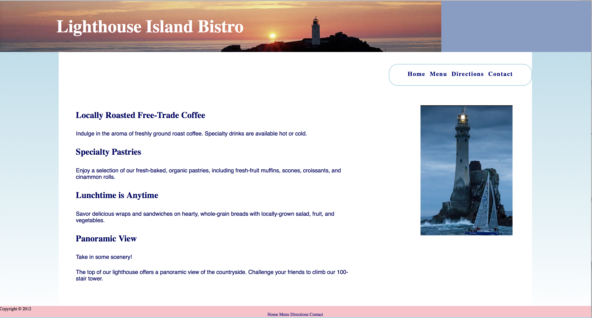
How am I going to improve my images?

Slide 11
How am I going to improve my images?
STEP 1
STEP 2 & 3

Slide 12
How am I going to improve my images?
STEP 1
  header{ ….. background-repeat: repeat;…}
STEP 2
  img{max-width: 100%; height: auto;object-fit: cover;}
STEP 3
  #image-place{display: flex; align-content: center; justify-content: center; padding:10%;}

